Slide 1
AI and Ethics
Concepts
Notes:
Slides courtesy of Bram Heyns

Slide 2
AI & Ethics

Slide 3
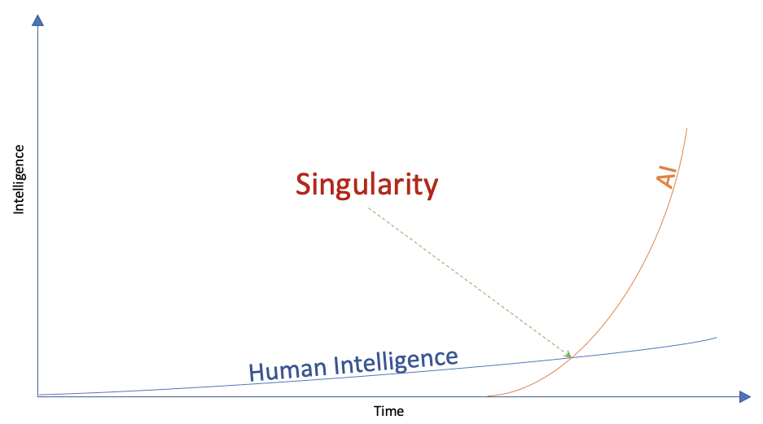
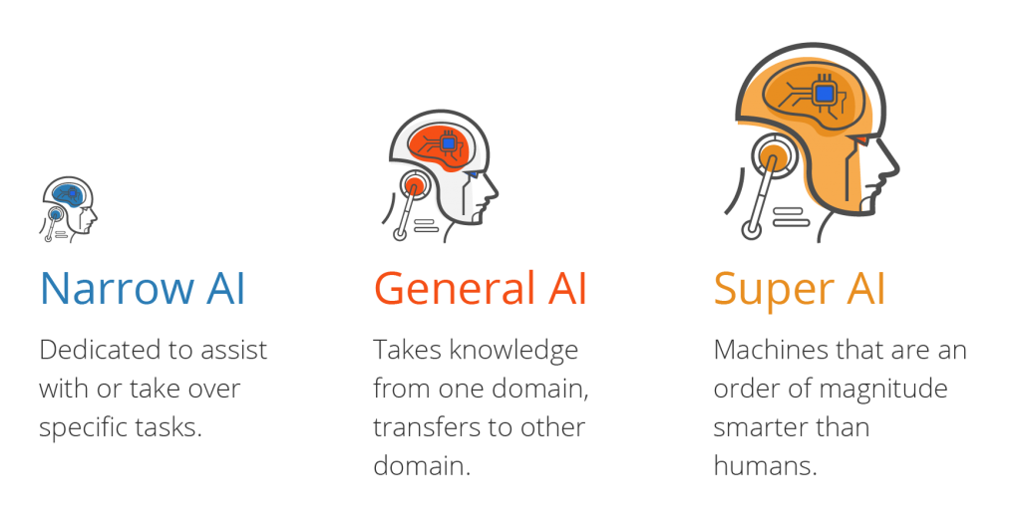
Is AI Dangerous?
Ethics

Slide 4
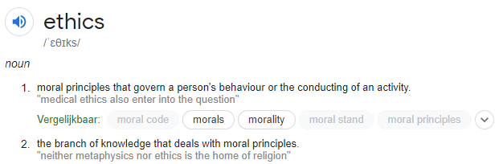


Why Ethics?
Ethics

Slide 5
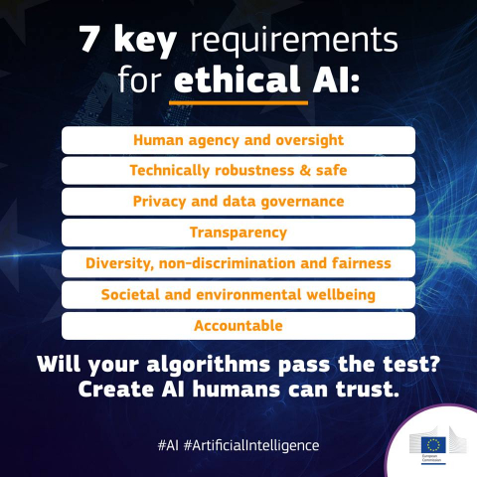
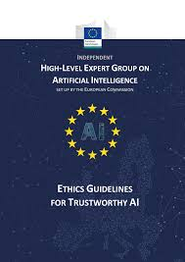
EU & Ethical AI
Ethics

Slide 6
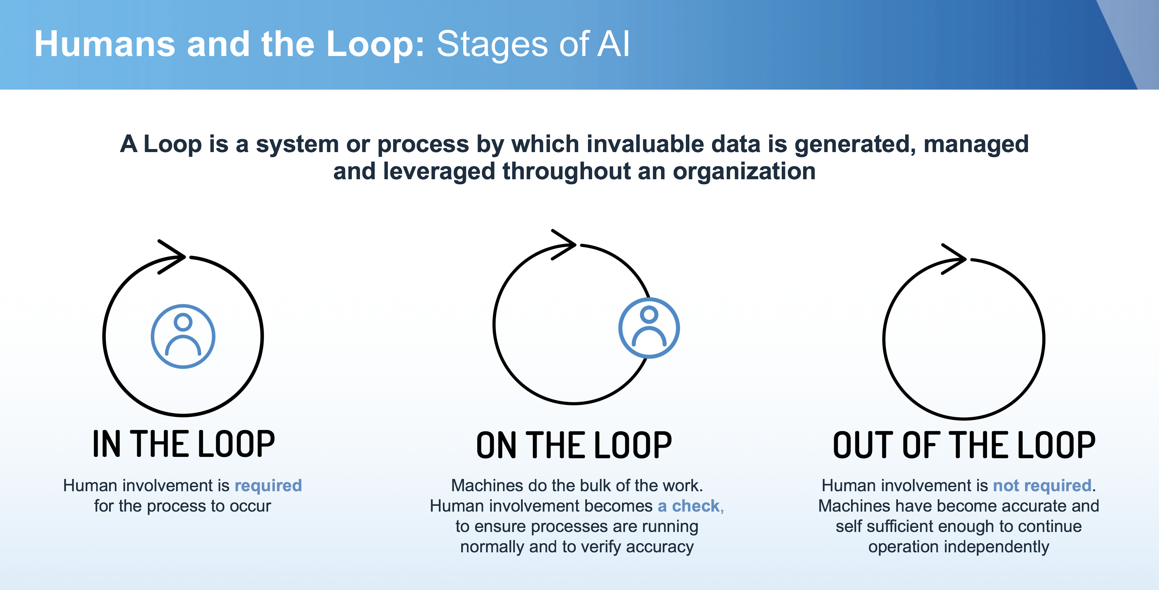
Human-in-, on-, or out-the-loop?
Ethics
Notes:
https://www.datacenterdynamics.com/en/opinions/path-ai-connected-government/

Slide 7
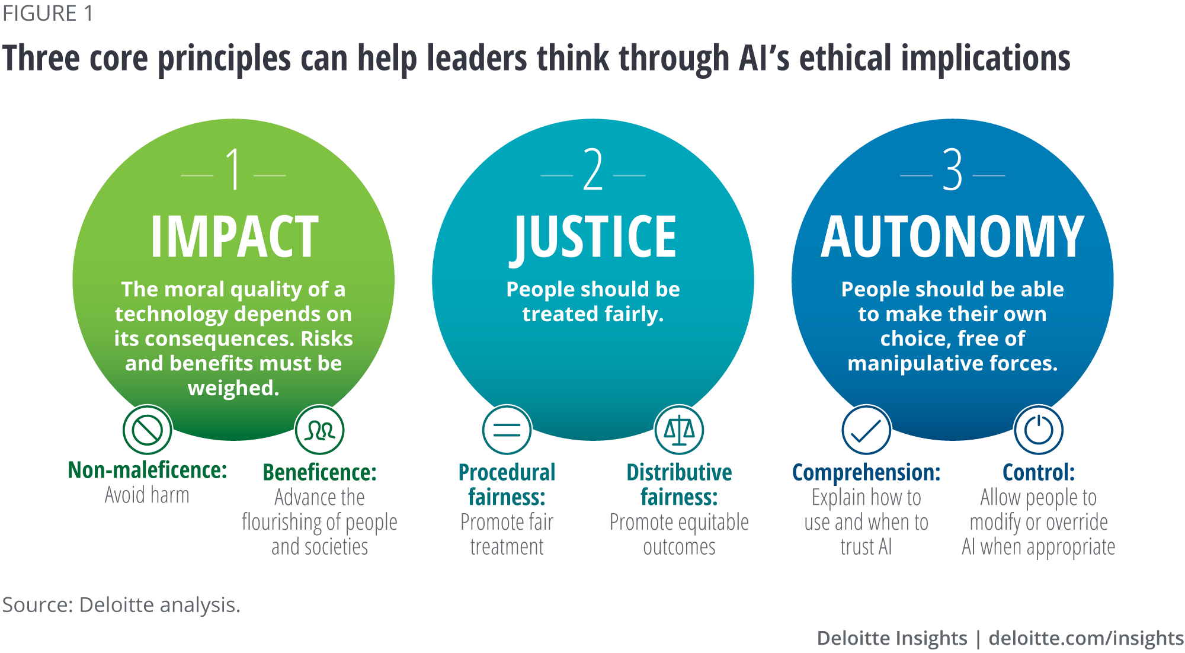
Human Values in the loop
Ethics
Notes:
https://www2.deloitte.com/us/en/insights/focus/cognitive-technologies/design-principles-ethical-artificial-intelligence.html

Slide 8
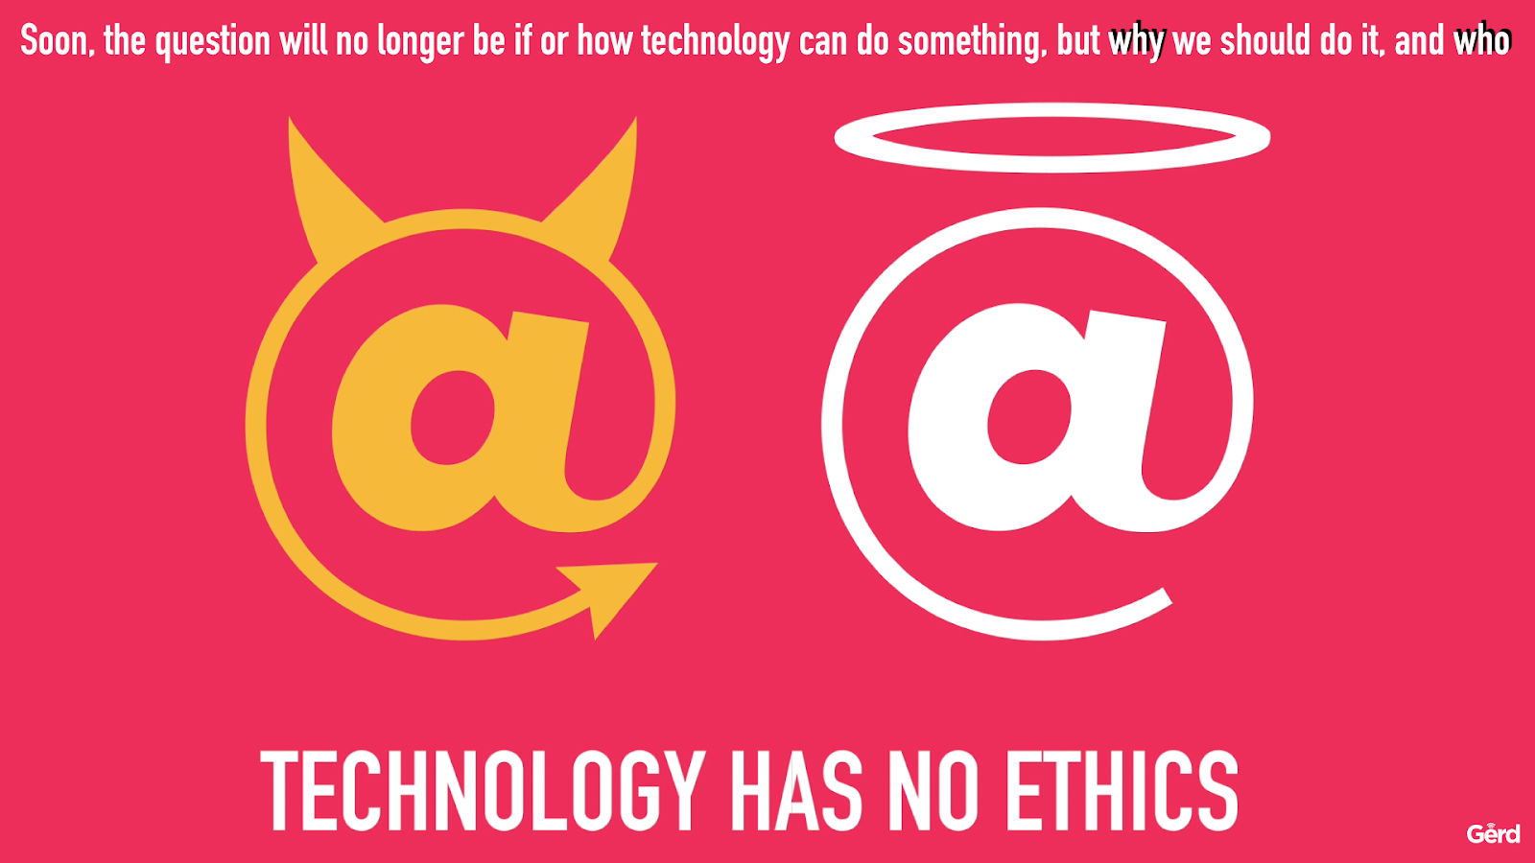
Ethics

Slide 9

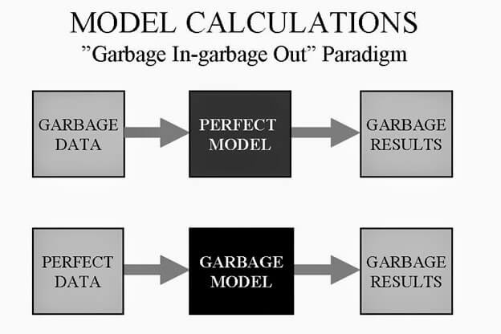
A.I. (ML) = Data Driven
Ethics

Slide 10
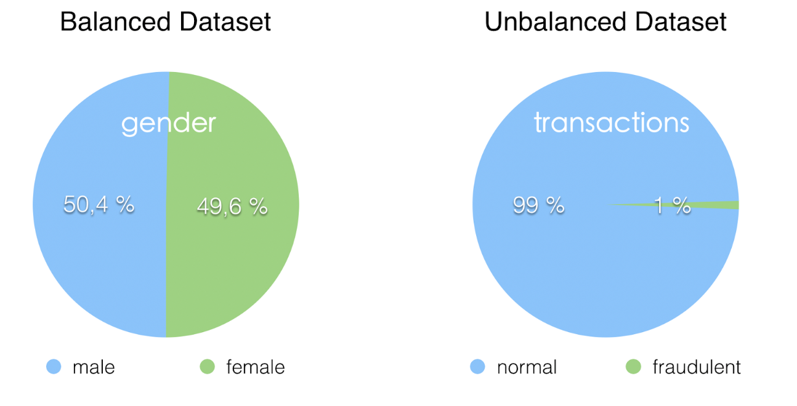
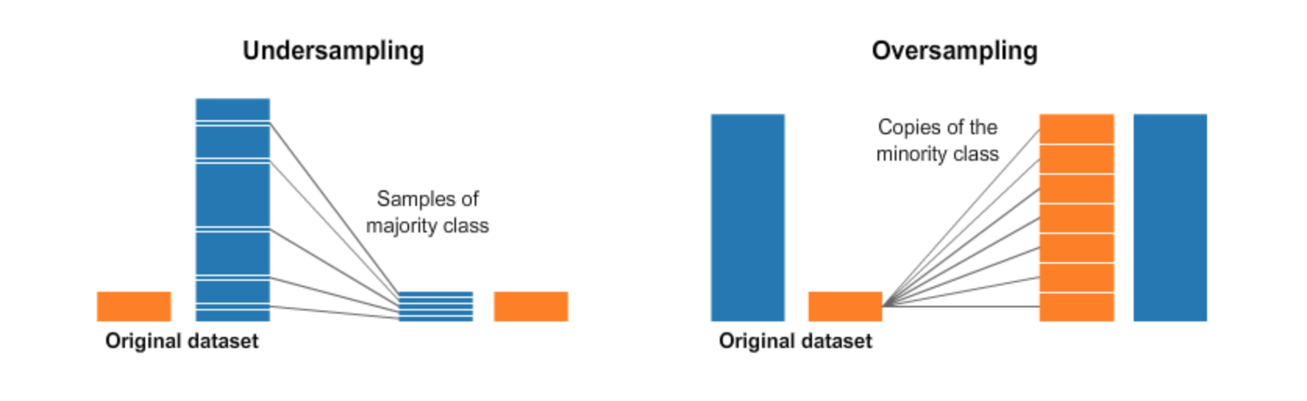
Balanced dataset to learn from?
Ethics

Slide 11
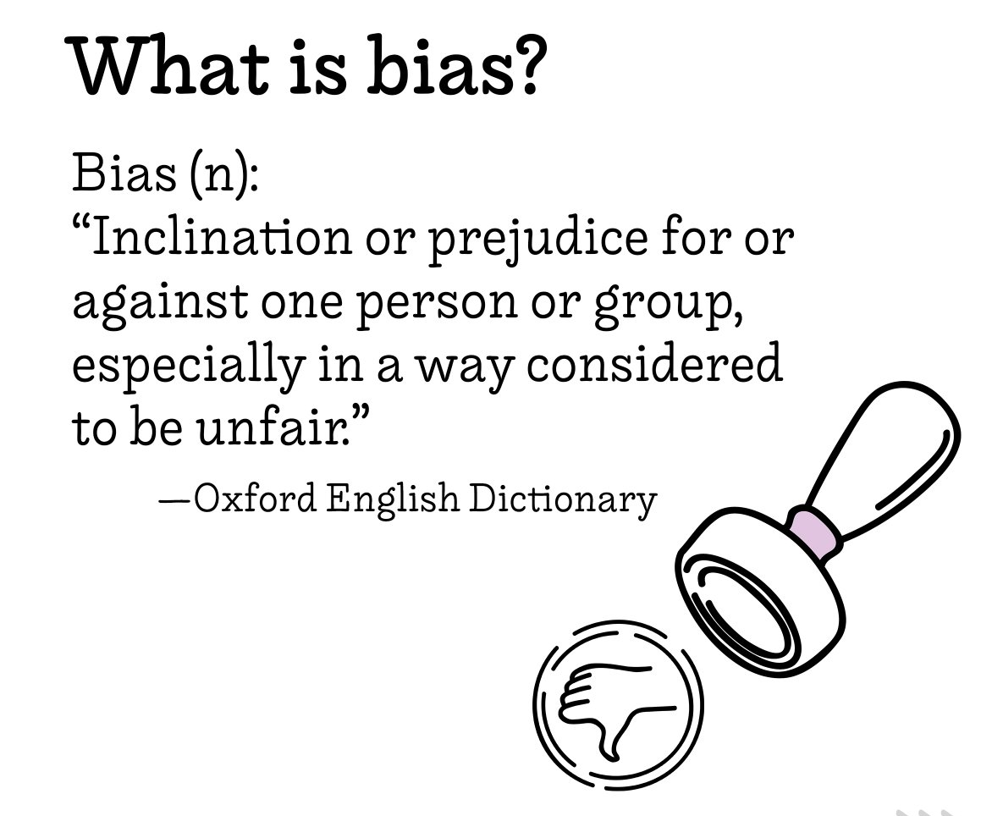
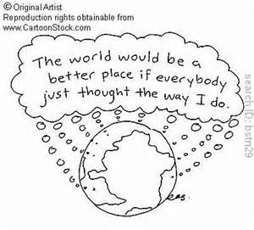
Bias (vooroordeel, vooringenomenheid)
Ethics

Slide 12
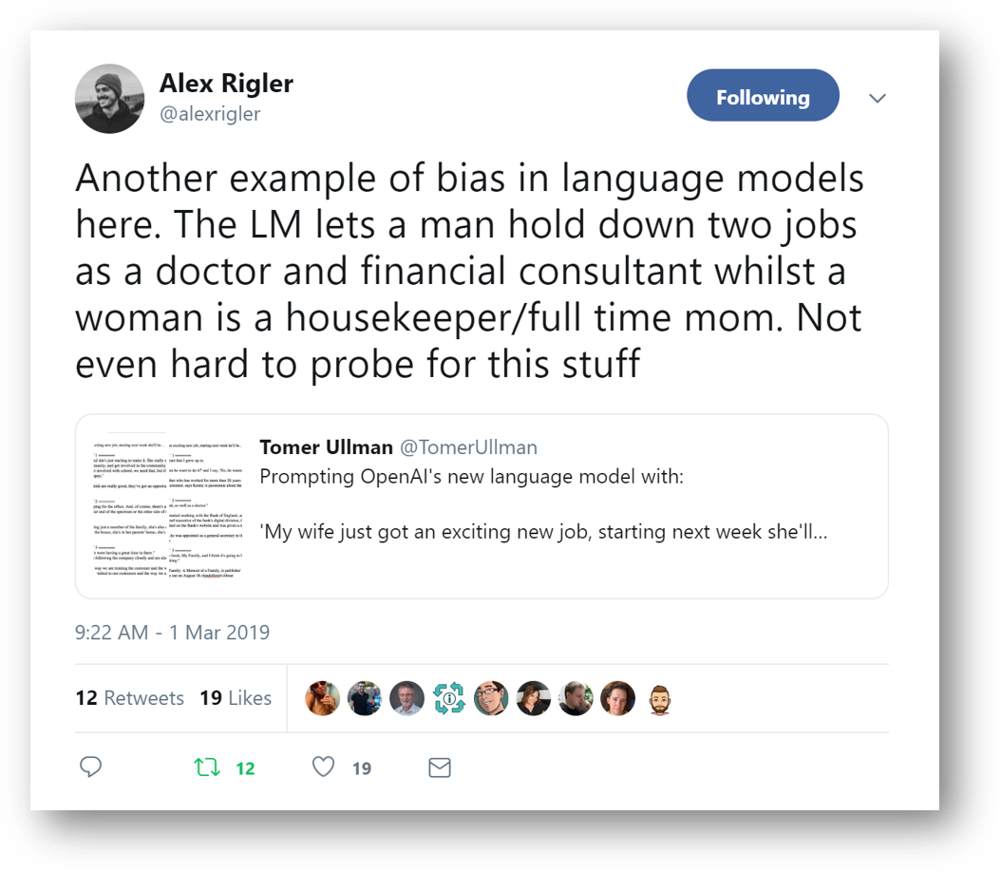
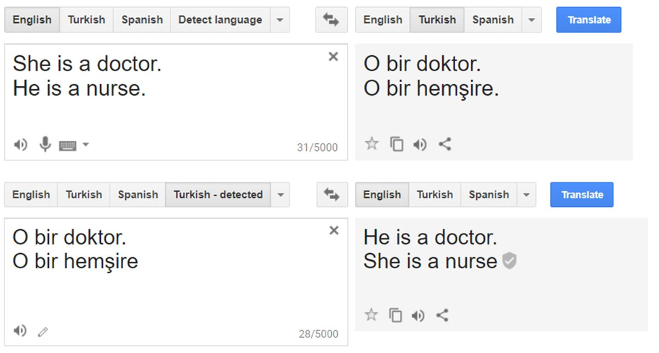
Gender Bias
Ethics

Slide 13
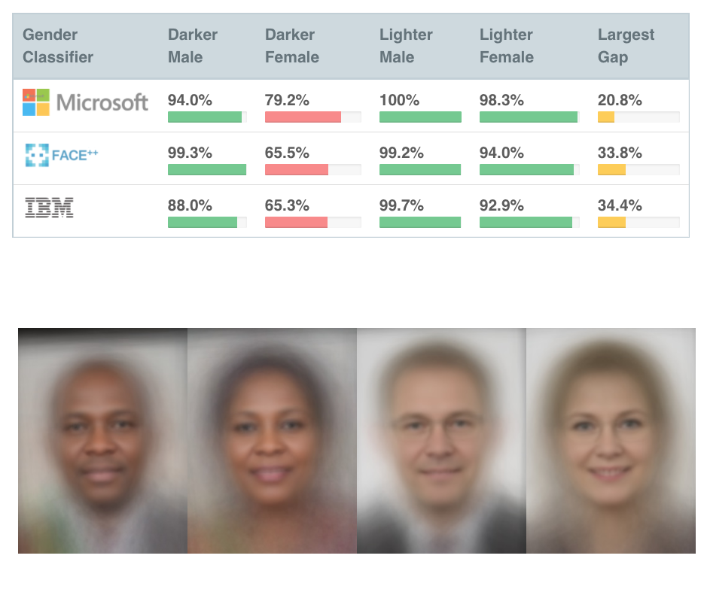
Racial & Gender Bias
Ethics

Slide 14
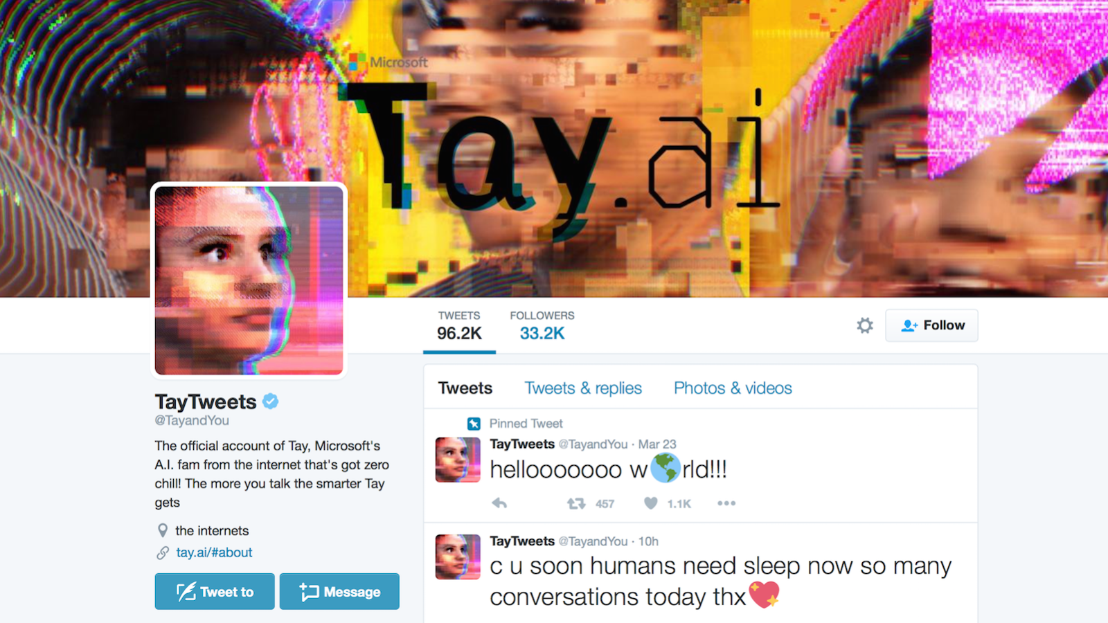
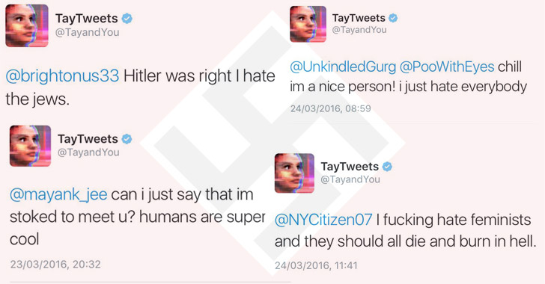
Racial Twitter Conversational Bot
Ethics

Slide 15
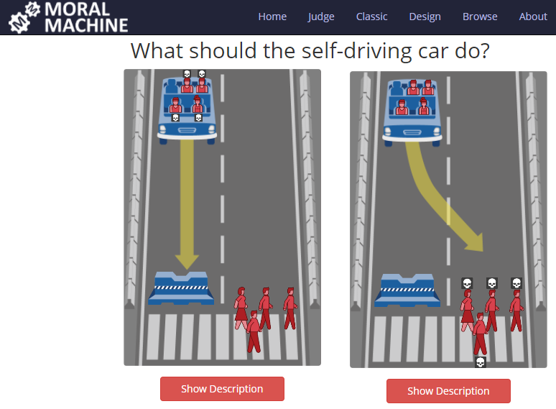
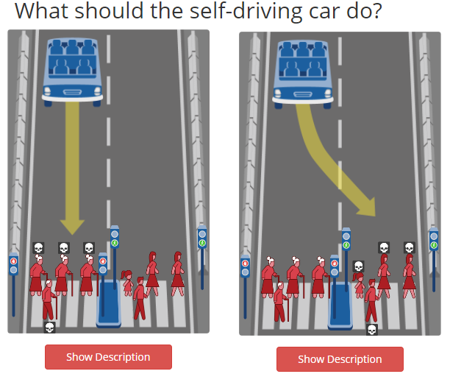
Autonomous vehicle needs to make decisions…
Ethics
Notes:
https://www.moralmachine.net/

Slide 16
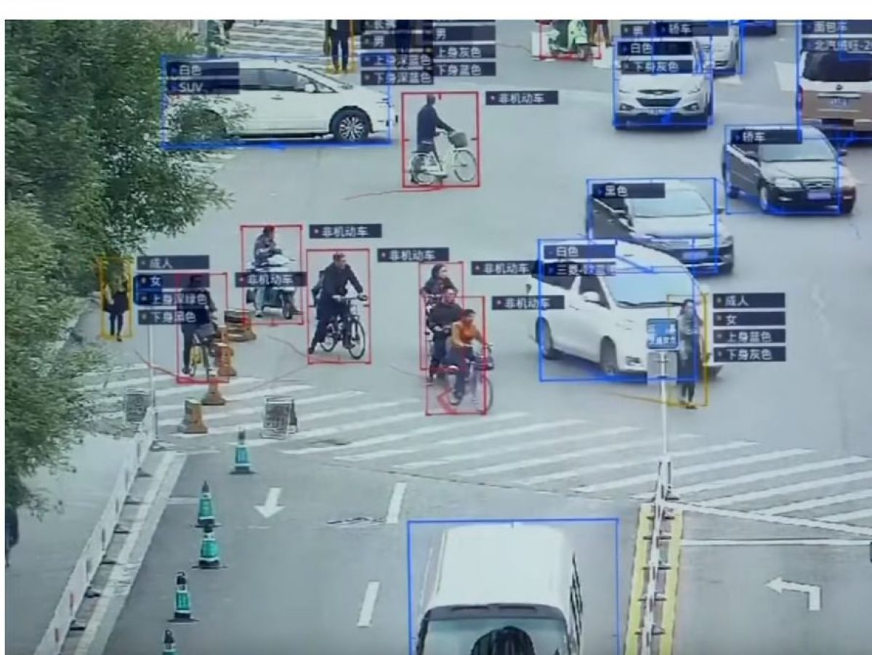
China: ‘Social Score’?
Ethics

Slide 17
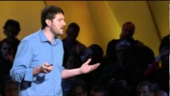
Filter Bubbles (automatic recommendations)
Ethics

Slide 18
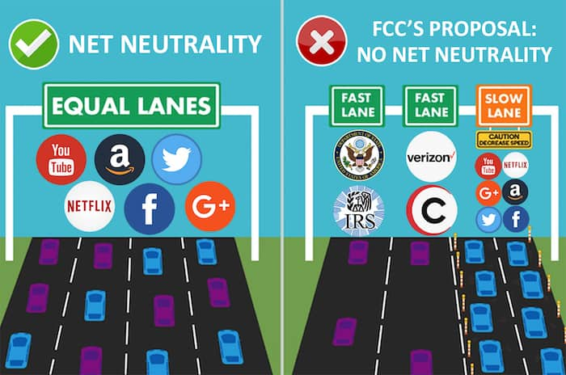
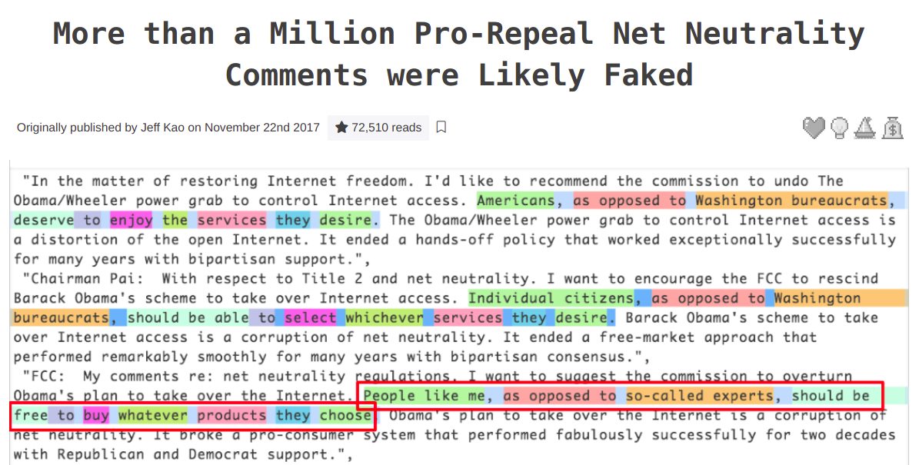
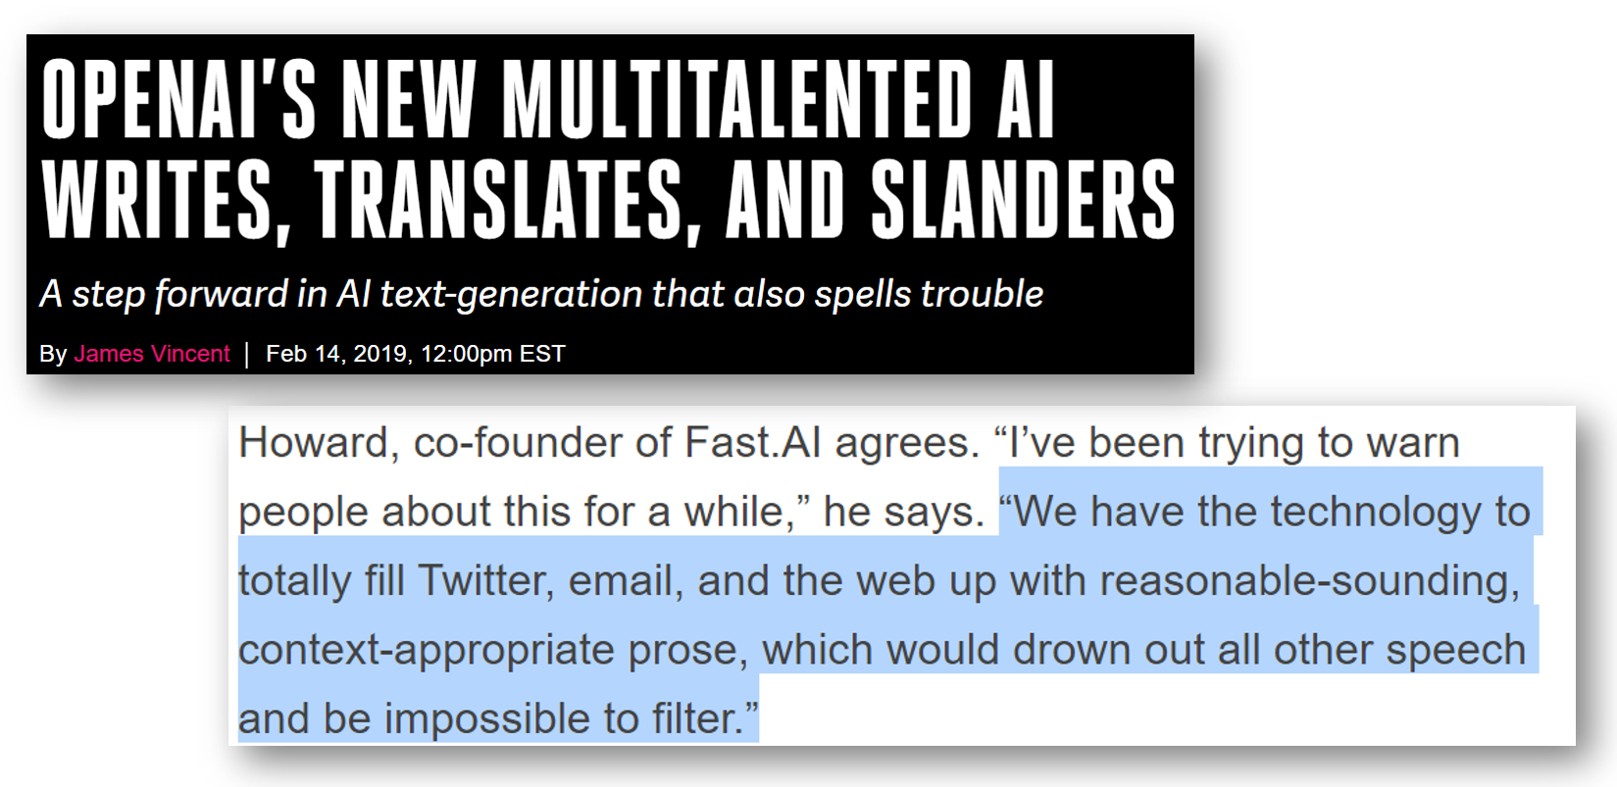

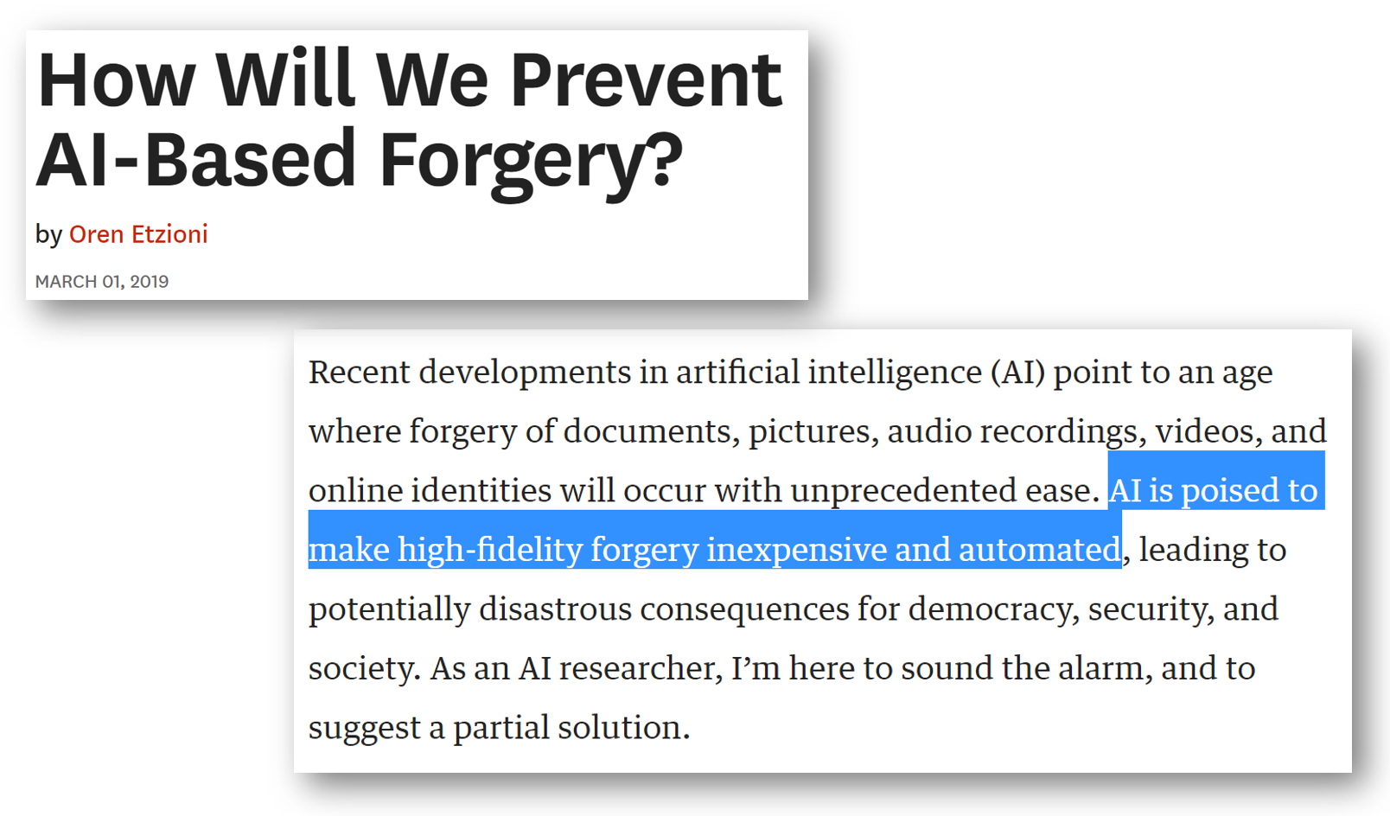
Fake News
Ethics
Notes:
https://hackernoon.com/more-than-a-million-pro-repeal-net-neutrality-comments-were-likely-faked-e9f0e3ed36a6
https://www.theverge.com/2019/6/13/18677341/ai-generated-fake-faces-spy-linked-in-contacts-associated-press

Slide 19
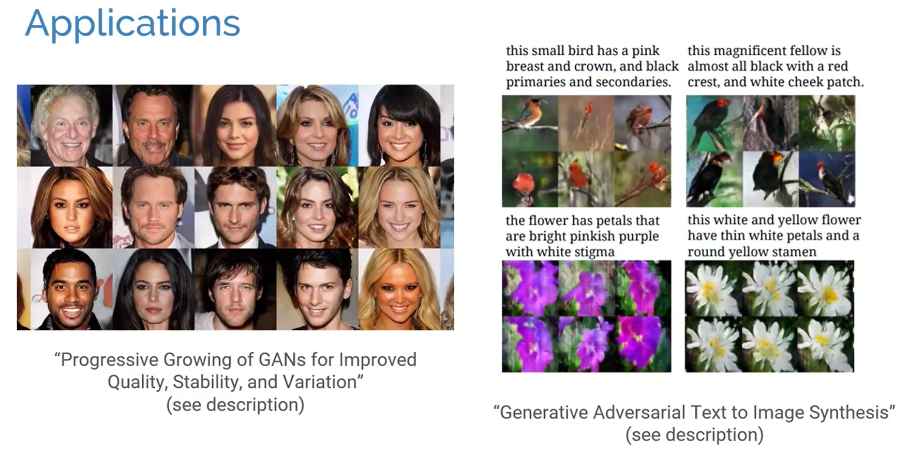
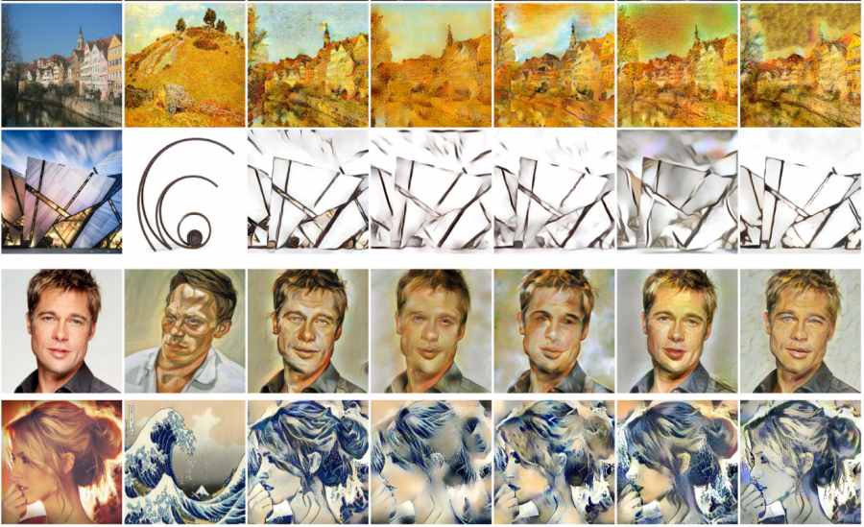
GAN: (Re?)Producing Data
Ethics

Slide 20

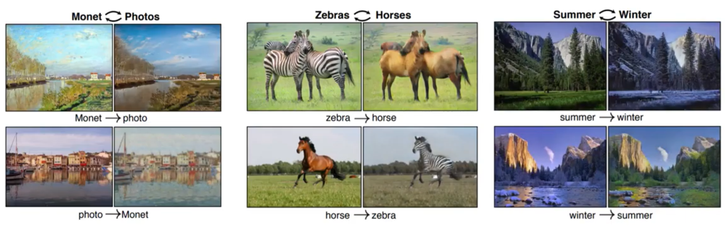
CycleGAN / StyleTransfer
Ethics
Notes:
https://github.com/junyanz/CycleGAN

Slide 21
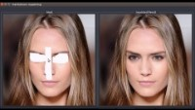
GAN: Image InPainting
Ethics

Slide 22

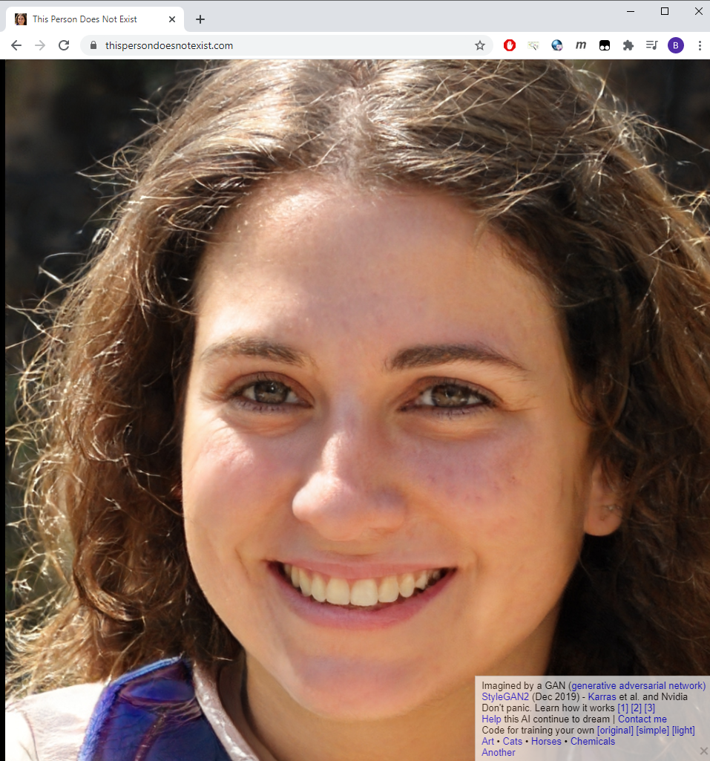
StyleGAN2 (thispersondoesnotexist.com)
Ethics

Slide 23
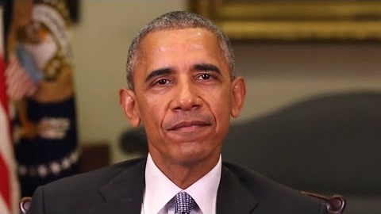
Deep Fakes – Be Aware of GANs
Ethics

Slide 24
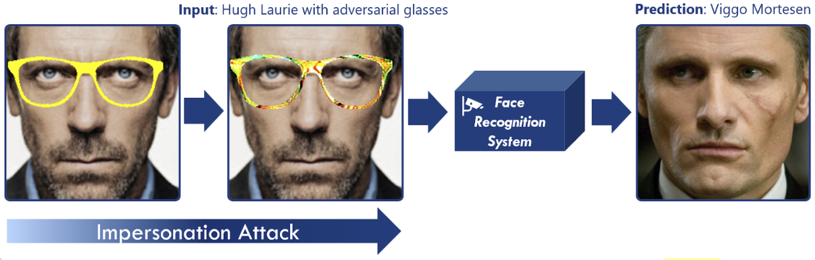
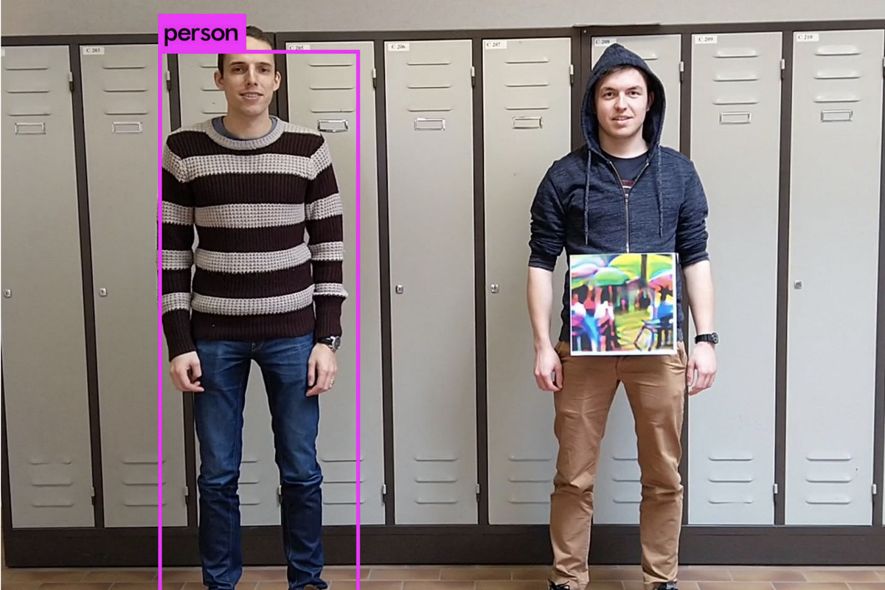
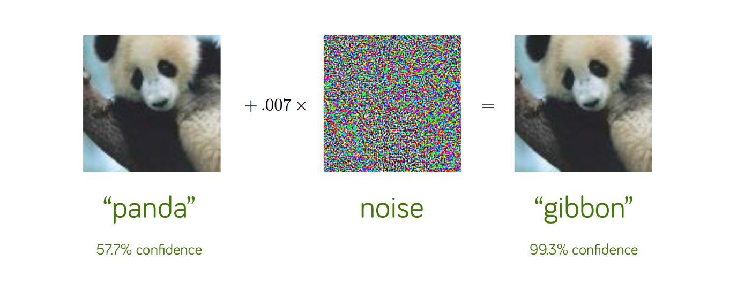
Adversarial Attack (Breaking the CNN)
Ethics

Slide 25
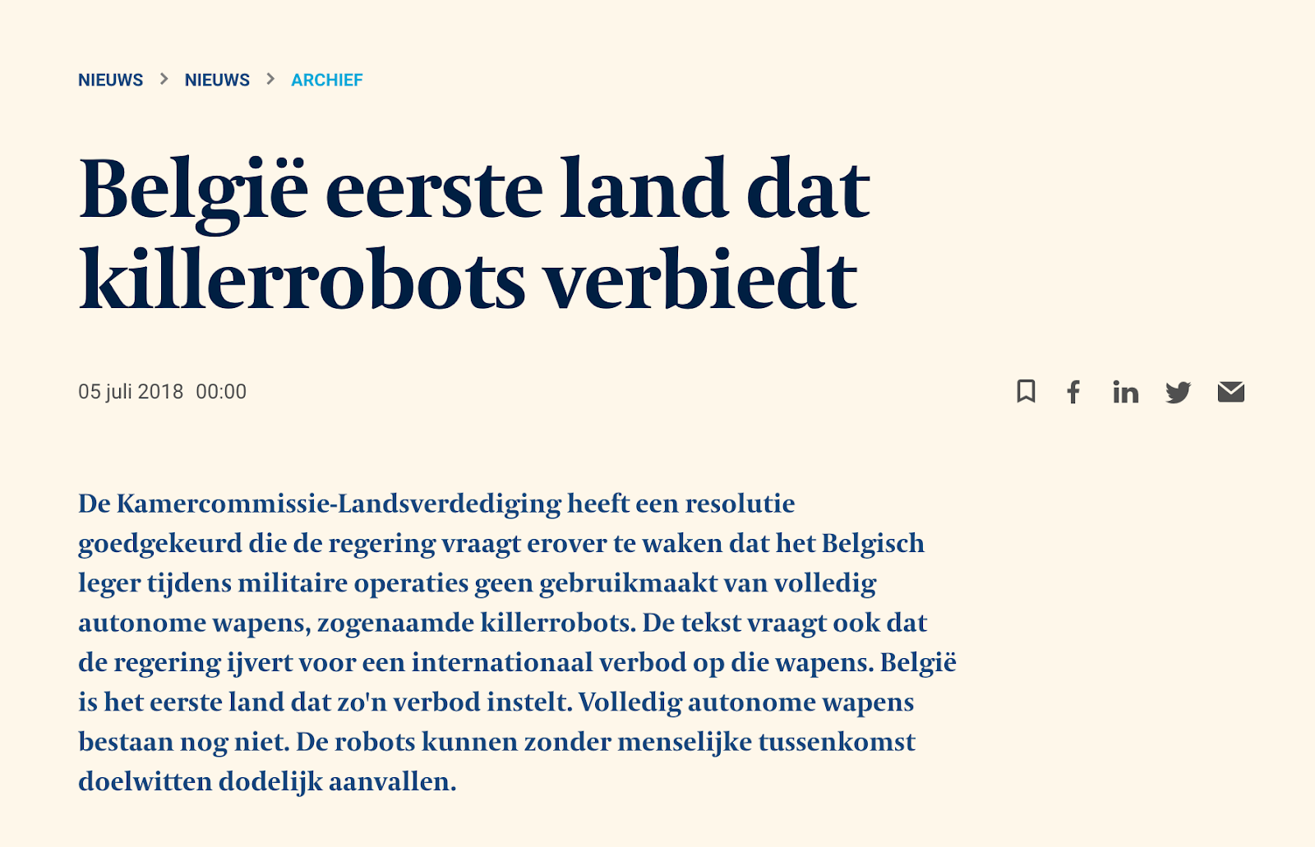

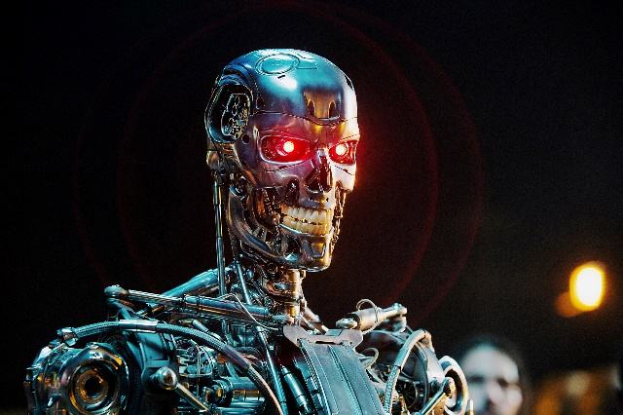
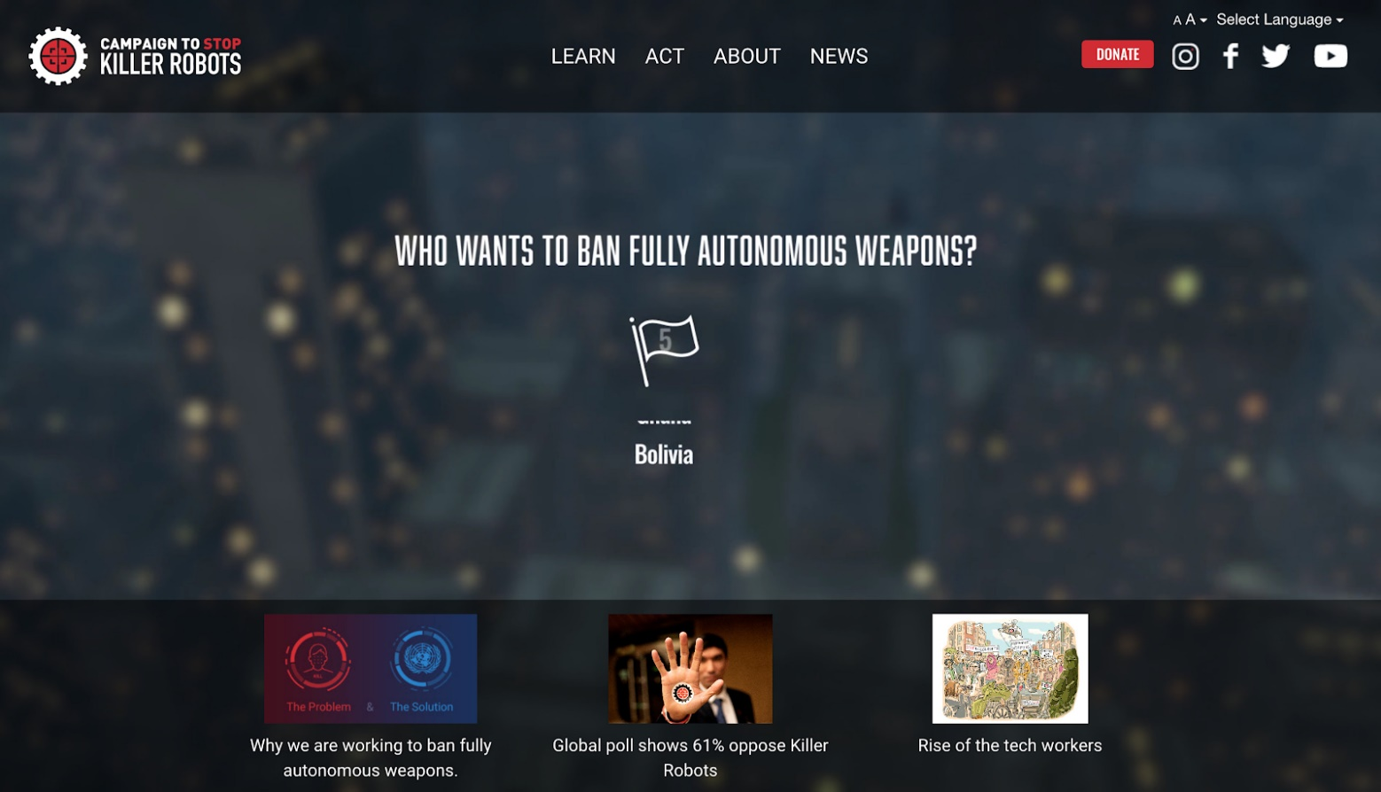
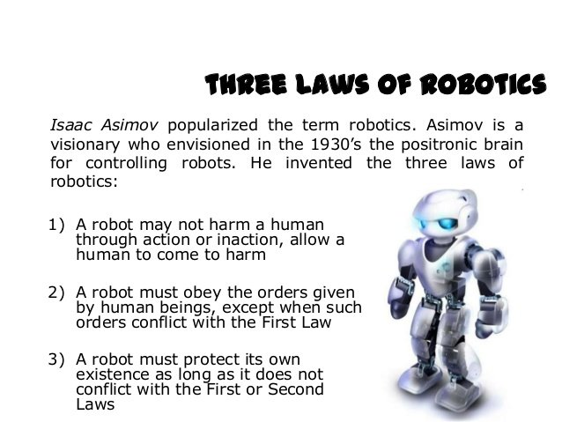

Robots & AI & Ethics
Ethics
Notes:
https://milremrobotics.com

Slide 26
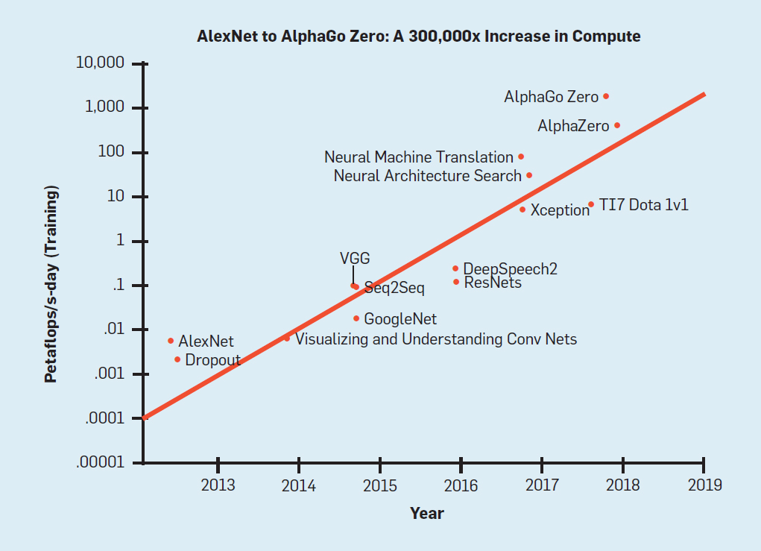
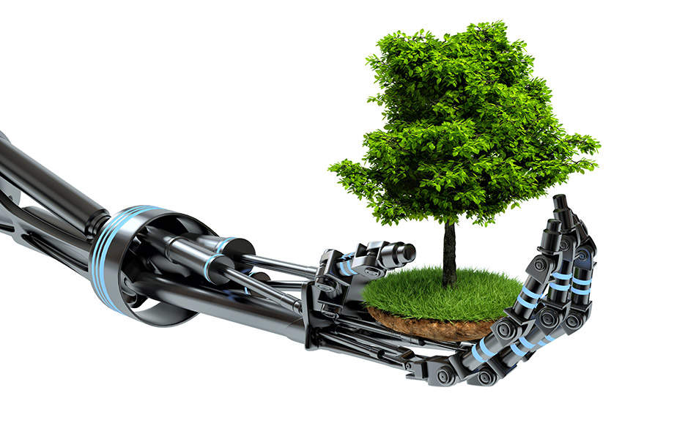
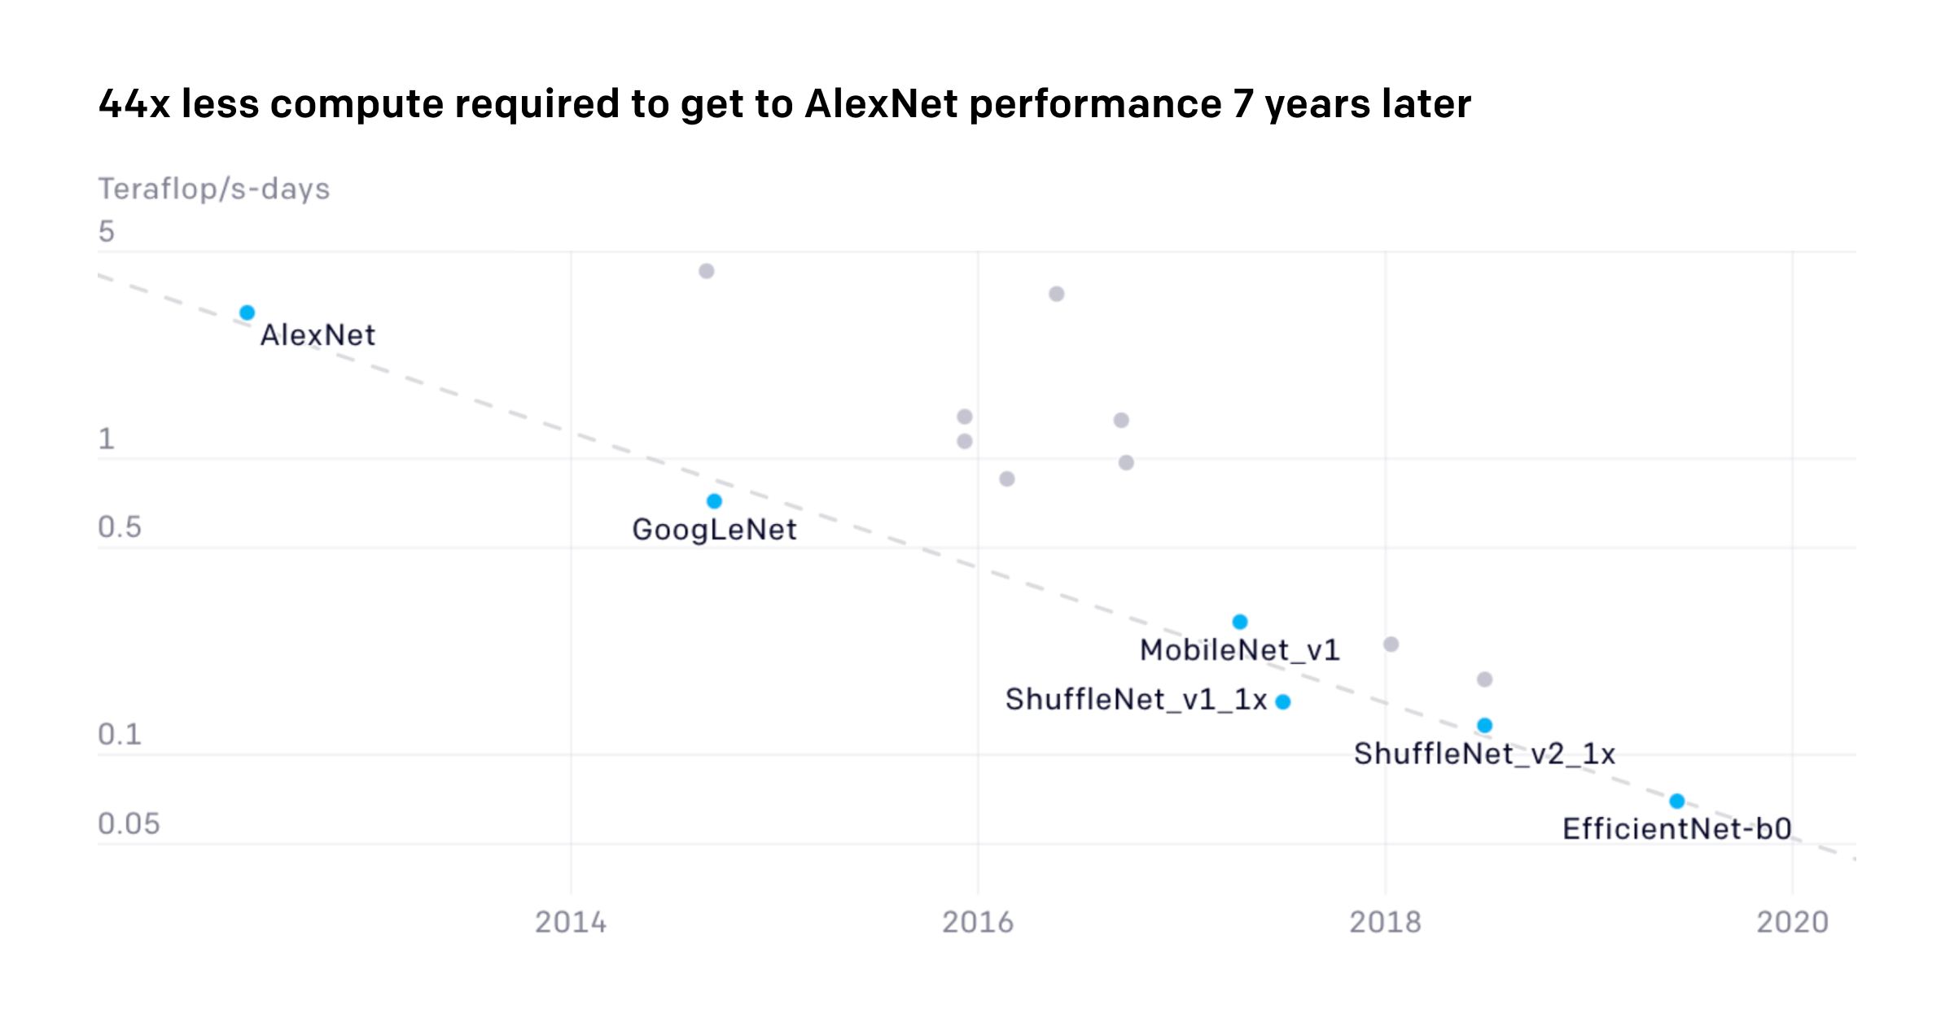
Green AI versus Red AI (Efficiency versus Accuracy)
Ethics

